Slide 1

San Francisco based company founded in 2009
car sharing, using technology to connect passengers and drivers
flexibility for the drivers and the convenience for the passengers
does not operate its own cars
no money exchange between the driver and the passenger

Slide 2
Uber History ?
UberCab 2009: CEO Travis Kalanick & Garrett Camp
2010 : IOS & Android app released
2011: raised $50M from investors
Sep 4, 2013: First Sports Deal-NFL Partnership
From San Francisco in 2010 to 19 countries (35 cities)
2015 : 60+ Countries and 240+cities
Why it Works
Everyone’s private driver
One thing, and doing it well
Constant Customer interaction for improvements
Uber has no drivers as an employee
Driver join the network, get paid and Uber takes commision

Slide 3
Questions
Dataset
It is a public Uber trip dataset for New York City for date range from Apr-2014 to Sep-2014 and
it has 4,451,746 trip records
The dataset have been anonymized by removing names, trip start and end points. Date and time of day are still intact.
The dataset has the information of: Trip start Date/Time, Pickup Latitude, Pickup Longitude, Base Company
What is the daily rush hours for trips
How does usage change weekly base
Does Uber mostly used by business people for work/home trips
Compare week days to weekend trips
Where does rider goes in weekdays and weekends (with some assumption)

Slide 4
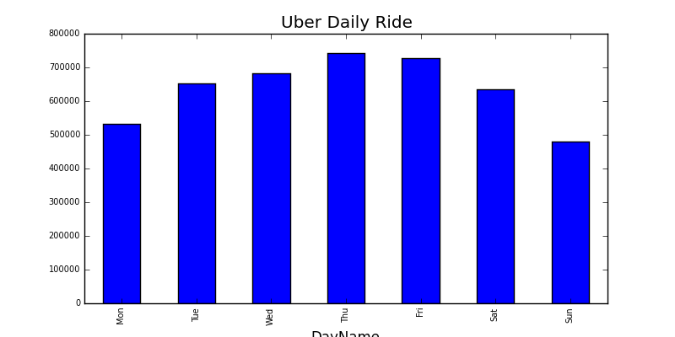
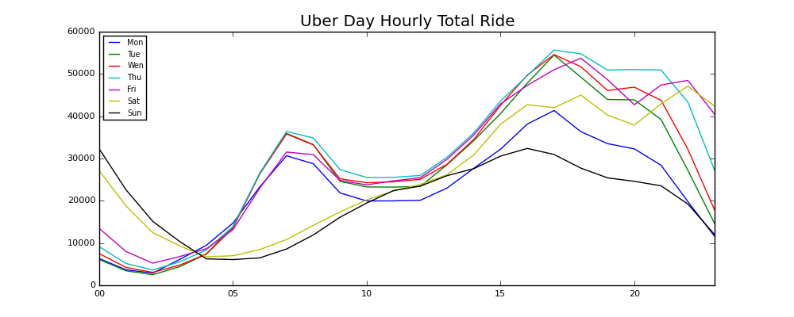
Results

Slide 5
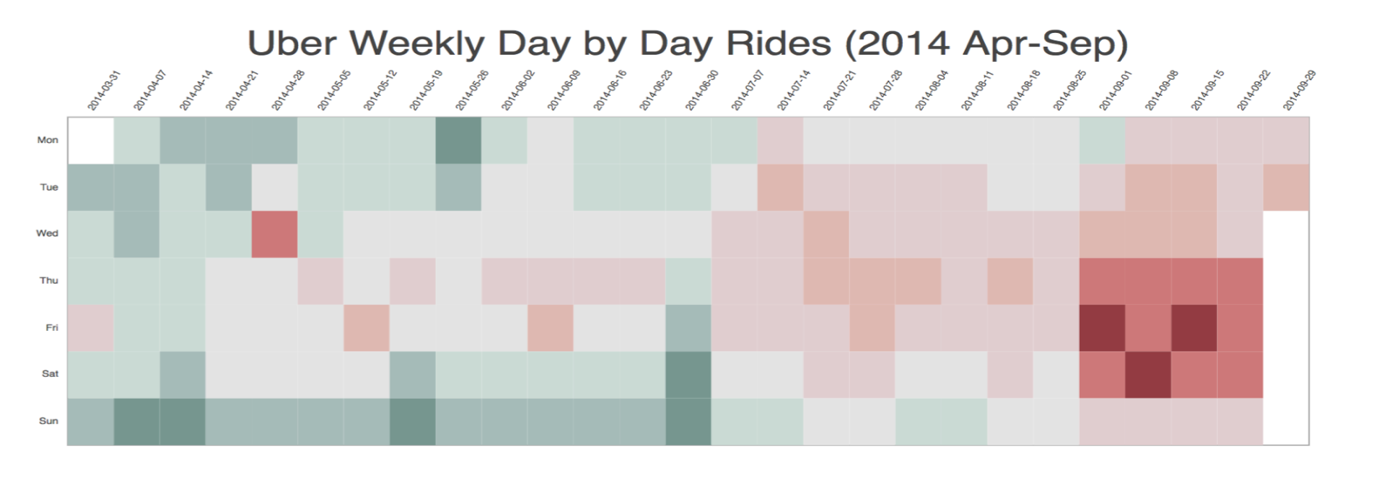
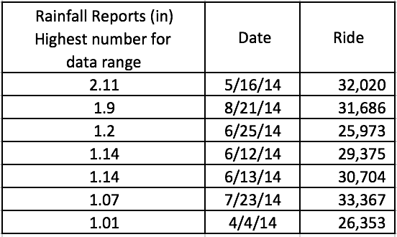
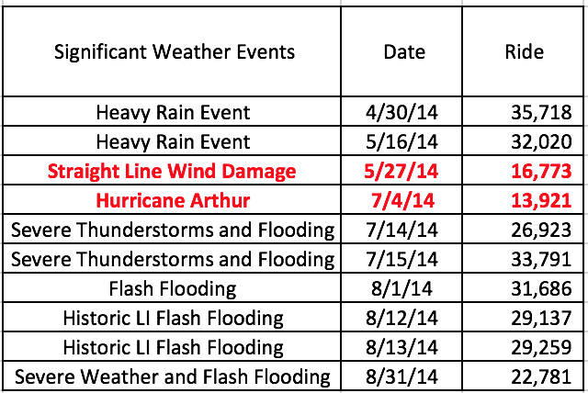
Results

Slide 6
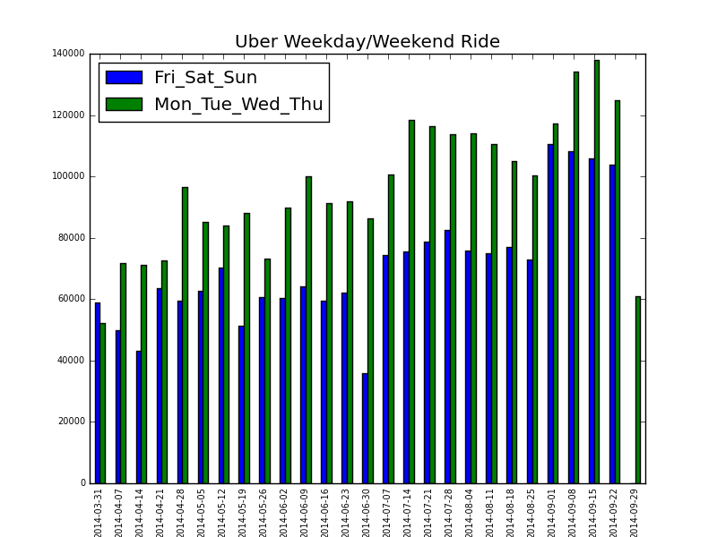
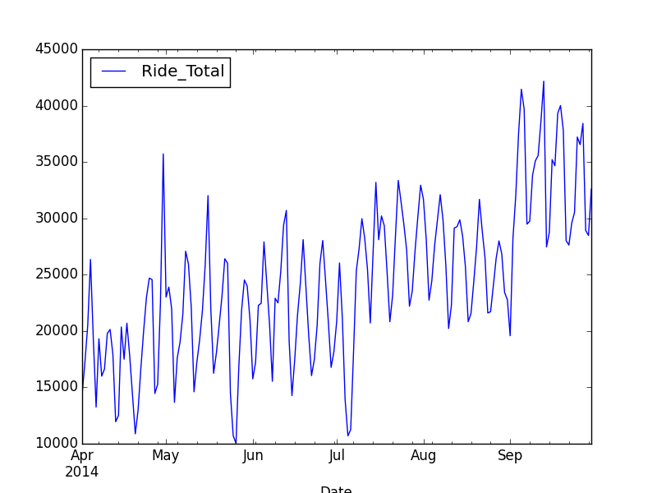
Result

Slide 7
Discussion & Answers
Q1: What is the daily rush hours for trips?
Morning peak time is around after 6am, and afternoon is after 3pm. Because the trend is going upwards during this time, meaning there are more request for rides. As we can see, Uber exhibits regular trends, supply and demand show daily patterns that peak around rush hour.
Q2: How does usage change weekly base?:
On the weekly plot,I was expecting to see the more rides during the weekend because of the night time activities in New York, however the graph shows more activity during the weekdays.
Q3: Does Uber mostly used by business people for work/home trips?:
I can only predict the answer for this question, because I could not find any data to give complete answer. However, because we are able to see the rush hour trends from the graphs easily, I can assume that the riders are the business people or students whose regular hours are 8am and 5pm.
Q4: Compare week days to weekend trips:
I expected to see more rides during the weekend for New York City, however weekday rides were higher for all data, which is opposite of San Francisco (Source). I can assume that this is because New York City is a business center
Q5: Where does rider goes in weekdays and weekends (with some assumption)?:
I could not find any clear difference to specify this. For example, in both times airports were popular locations.

Slide 8
Conclusion & Future Work
My aim was to answer my questions, and I could be able to do so
My paper show a correlation between weather conditions and rider request.
Uber will need more driver in their platform during this time
This may help Uber drivers predict their income by following forecast.
Not enough data for detailed analyze. We need data for several years
Local weather history is hard to find
Future of Uber is very optimistic, it is a very popular app
However has to solve legal problems
Is Google's investment in Uber the start of a Nexus car (self-driving vehicles) program?

